Slide 1


Name: Nikita Rajendra Petkar
Date: 28/03/2022

Slide 2

Outline
Executive Summary
Introduction
Methodology
Results
Conclusion
Appendix

Slide 3
Executive Summary
Collected data from public SpaceX API and SpaceX Wikipedia page. Created labels column ‘class’ which classifies successful landings. Explored data using SQL, visualization, folium maps, and dashboards. Gathered relevant columns to be used as features. Changed all categorical variables to binary using one hot encoding. Standardized data and used GridSearchCV to find best parameters for machine learning models. Visualize accuracy score of all models.
Four machine learning models were produced: Logistic Regression, Support Vector Machine, Decision Tree Classifier, and K Nearest Neighbors. All produced similar results with accuracy rate of about 83.33%. All models over predicted successful landings. More data is needed for better model determination and accuracy.

Slide 4
Introduction
Background:
Commercial Space Age is Here
Space X has best pricing ($62 million vs. $165 million USD)
Largely due to ability to recover part of rocket (Stage 1)
Space Y wants to compete with Space X
Problem:
Space Y tasks us to train a machine learning model to predict successful Stage 1 recovery

Slide 5

Section 1

Slide 6
Methodology
Executive Summary
Data collection methodology:
Combined data from SpaceX public API and SpaceX Wikipedia page.
Perform data wrangling
Classifying true landings as successful and unsuccessful otherwise.
Perform exploratory data analysis (EDA) using visualization and SQL
Perform interactive visual analytics using Folium and Plotly Dash
Perform predictive analysis using classification models
Tuned models using GridSearchCV

Slide 7
Data Collection
Data collection process involved a combination of API requests from Space X public API and web scraping data from a table in Space X’s Wikipedia entry.
The next slide will show the flowchart of data collection from API and the one after will show the flowchart of data collection from webscraping.
Space X API Data Columns:
FlightNumber, Date, BoosterVersion, PayloadMass, Orbit, LaunchSite, Outcome, Flights, GridFins,
Reused, Legs, LandingPad, Block, ReusedCount, Serial, Longitude, Latitude
Wikipedia Webscrape Data Columns:
Flight No., Launch site, Payload, PayloadMass, Orbit, Customer, Launch outcome, Version Booster, Booster landing, Date, Time

Slide 8
Data Collection – SpaceX API
Request (SpaceX APIs)
.JSON file + Lists(Launch Site, Booster Version, Payload Data)
Json_normalize to DataFrame data from JSON
Dictionary relevant data
Cast dictionary to a DataFrame
Filter data to only include Falcon 9 launches
Imputate missing PayloadMass values with mean
GitHub:
https://github.com/nikitapetkar29/IBMcapstoneproject/blob/master/Data%20Collection%20API%20Lab.ipynb

Slide 9
Request Wikipedia html
BeautifulSoup html5lib Parser
Find launch info html table
Create Dictionary
Iterate through table cells to extract data to dictionary
Cast dictionary to DataFrame
Data Collection - Scraping

Slide 10
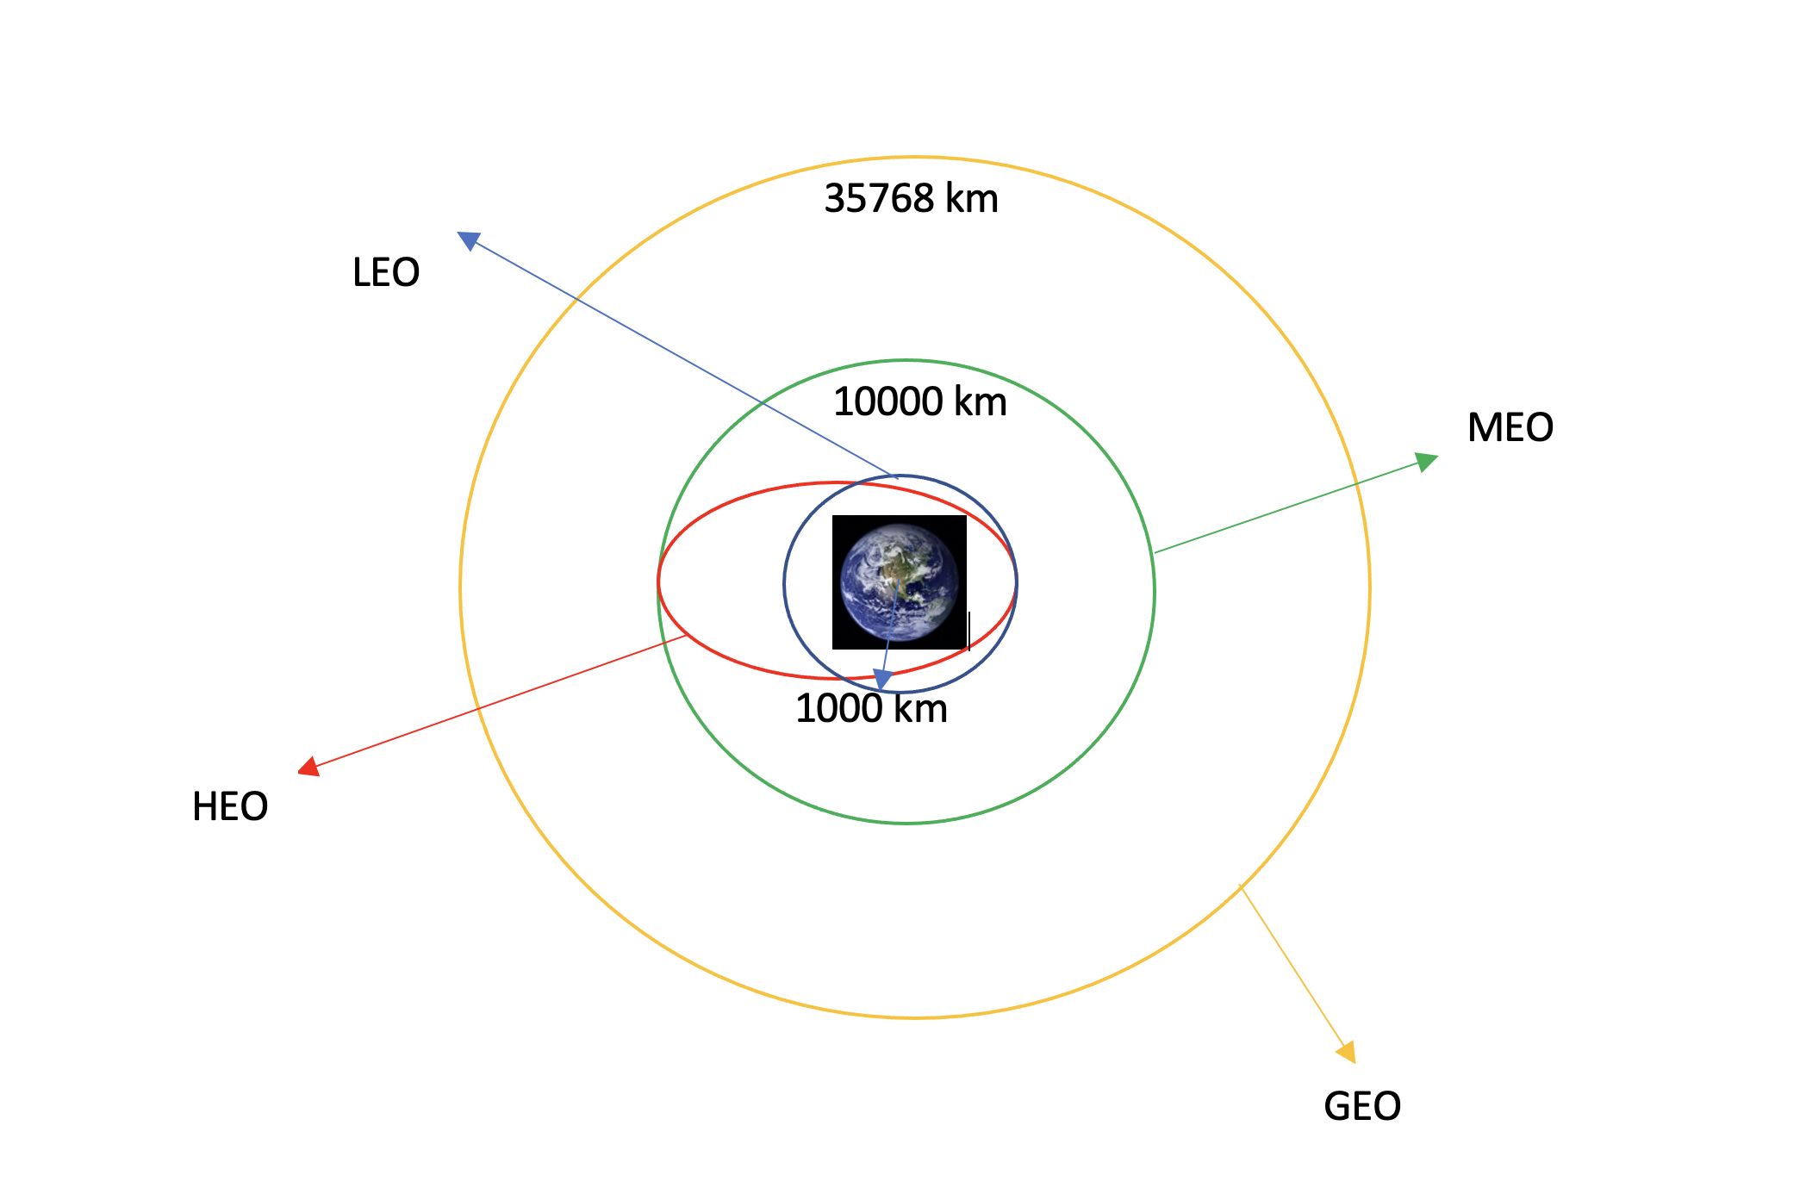
Data Wrangling
We performed exploratory data analysis and determined the training labels.
We calculated the number of launches at each site and the number and occurrence of each orbits.
We created landing outcome label from outcome column and exported the results to csv.
GitHub: https://github.com/nikitapetkar29/IBMcapstoneproject/blob/master/EDA%20lab.ipynb

Slide 11
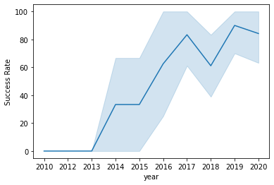
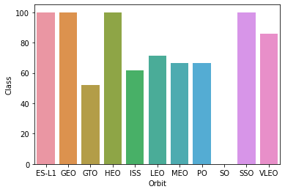
EDA with Data Visualization
We explored the data by visualizing the relationship between flight number and launch Site, payload and launch site, success rate of each orbit type, flight number and orbit type, the launch success yearly trend.
GitHub: https://github.com/nikitapetkar29/IBMcapstoneproject/blob/master/EDA%20with%20Visualization%20lab.ipynb

Slide 12
EDA with SQL
We loaded the SpaceX dataset into a PostgreSQL database without leaving the jupyter notebook.
We applied EDA with SQL to get insight from the data. We wrote queries to find out for instance:
The names of unique launch sites in the space mission.
The total payload mass carried by boosters launched by NASA (CRS)
The average payload mass carried by booster version F9 v1.1
The total number of successful and failure mission outcomes
The failed landing outcomes in drone ship, their booster version and launch site names.
GitHub: https://github.com/nikitapetkar29/IBMcapstoneproject/blob/master/EDA%20and%20SQL.ipynb

Slide 13
Build an Interactive Map with Folium
We marked all launch sites, and added map objects such as markers, circles, lines to mark the success or failure of launches for each site on the folium map.
We assigned the feature launch outcomes (failure or success) to class 0 and 1.i.e., 0 for failure, and 1 for success.
Using the color-labeled marker clusters, we identified which launch sites have relatively high success rate.
We calculated the distances between a launch site to its proximities. We answered some question for instance:
- Are launch sites near railways, highways and coastlines.
- Do launch sites keep certain distance away from cities.
GitHub: https://github.com/nikitapetkar29/IBMcapstoneproject/blob/master/Interactive%20Visual%20Analytics%20with%20Folium%20lab.ipynb

Slide 14
Build a Dashboard with Plotly Dash
We built an interactive dashboard with Plotly dash
We plotted pie charts showing the total launches by a certain sites
We plotted scatter graph showing the relationship with Outcome and Payload Mass (Kg) for the different booster version.

Slide 15
Predictive Analysis (Classification)
We loaded the data using numpy and pandas, transformed the data, split our
data into training and testing.
• We built different machine learning models and tune different
hyperparameters using GridSearchCV.
• We used accuracy as the metric for our model, improved the model using
feature engineering and algorithm tuning.
• We found the best performing classification model.
GitHub: https://github.com/nikitapetkar29/IBMcapstoneproject/blob/master/Machine%20Learning%20Prediction%20lab.ipynb

Slide 16
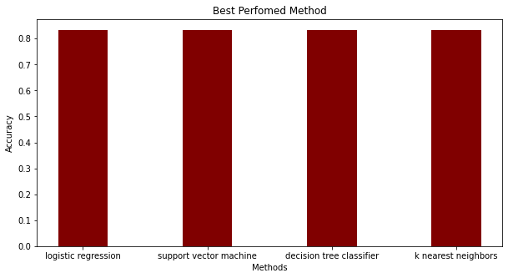
Results

Slide 17

Section 2

Slide 18
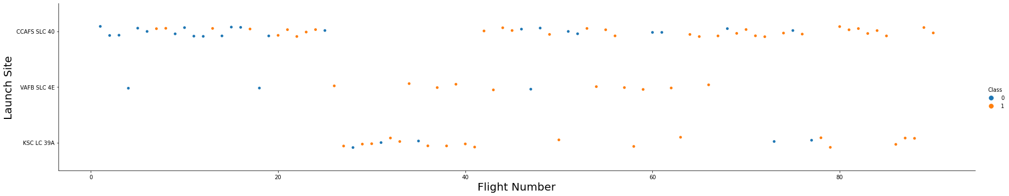
Flight Number vs. Launch Site
Scatter plot of Flight Number vs. Launch Site
From the scatter plot we can see that large amount of flights are at a launch site, the greater the success rate at a launch site.

Slide 19
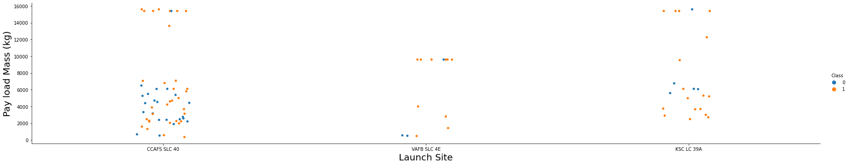
Payload vs. Launch Site
Scatter plot of Payload vs. Launch Site
The greater the payload mass for launch site CCAFS SLC 40 the higher the success rate for the rocket.

Slide 20
Success Rate vs. Orbit Type
From the plot, we can see that ES-L1, GEO, HEO, SSO,VLEO had the most success rate.

Slide 21
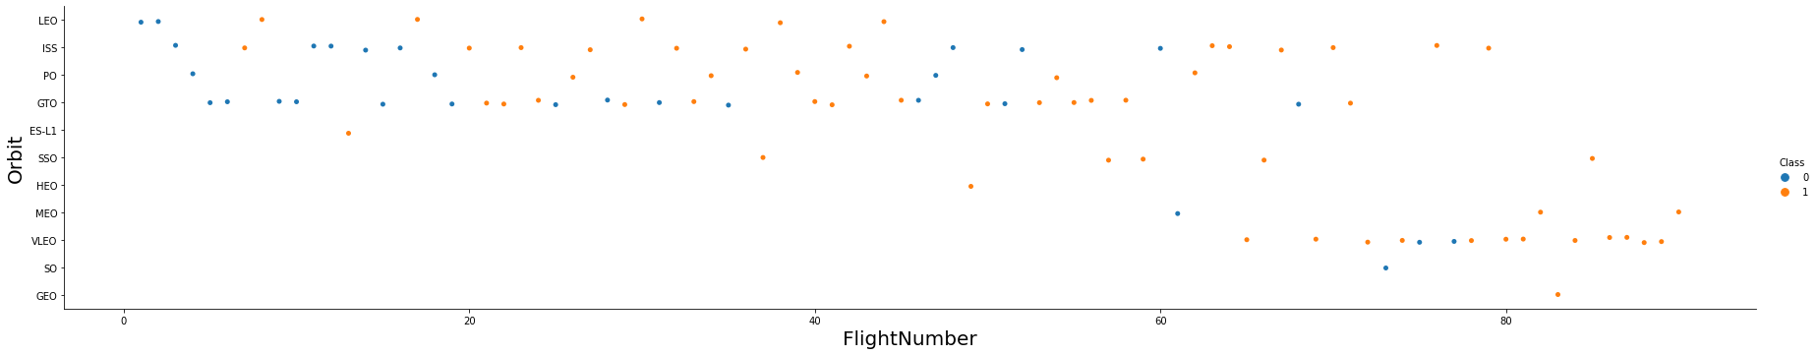
Flight Number vs. Orbit Type
Scatter point of Flight number vs. Orbit type
The plot below shows the Flight Number vs. Orbit type. We observe that in the LEO orbit, success is related to the number of flights whereas in the GTO orbit, there is no relationship between flight number and the orbit.

Slide 22
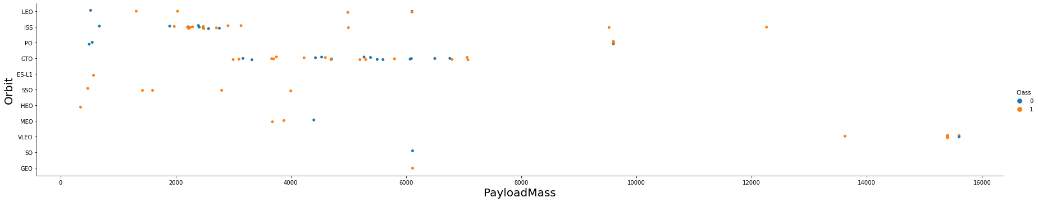
Payload vs. Orbit Type
Scatter point of payload vs. orbit type
We can observe that with heavy payloads, the successful landing are more for PO, LEO and ISS orbits.

Slide 23
Launch Success Yearly Trend
Line chart of yearly average success rate
From the plot, we can observe that success rate since 2013 kept on increasing till 2020.

Slide 24
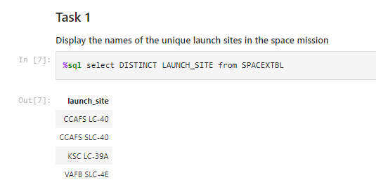
All Launch Site Names
We used DISTINCT to show only the unique launch sites from the SpaceX data.

Slide 25
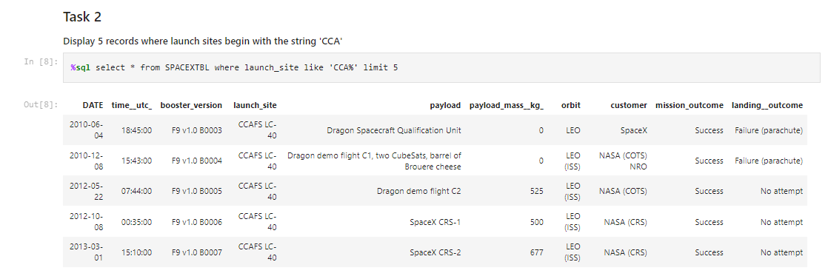
Launch Site Names Begin with 'CCA'
Find 5 records where launch sites begin with `CCA`
We used the query above to display 5 records where launch sites begin with `CCA`

Slide 26
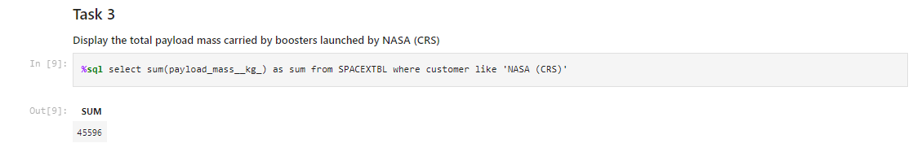
Total Payload Mass
Calculate the total payload carried by boosters from NASA

Slide 27
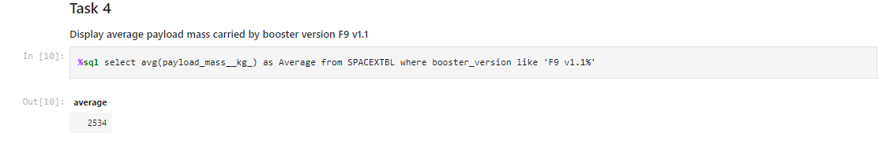
Average Payload Mass by F9 v1.1
Calculate the average payload mass carried by booster version F9 v1.1
We calculated the average payload mass carried by booster version F9 v1.1 as 2534.

Slide 28
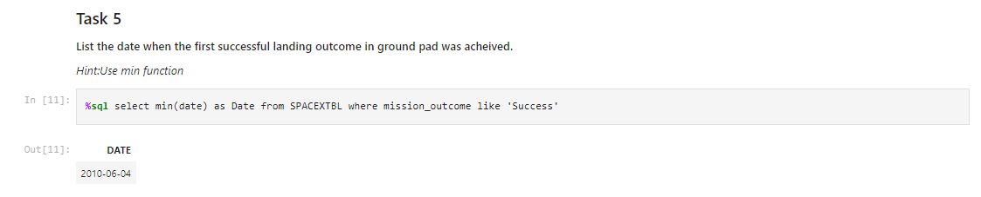
First Successful Ground Landing Date
Find the dates of the first successful landing outcome on ground pad
We observed that the dates of the first successful landing outcome on ground pad was 2010-06-04.

Slide 29
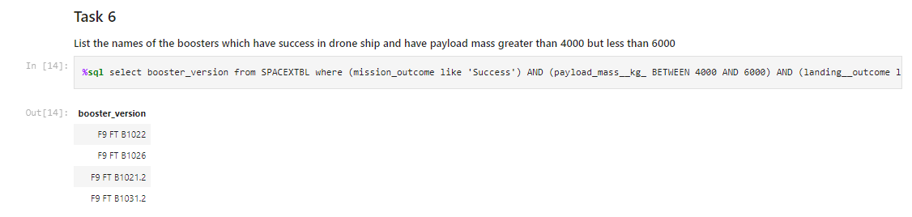
Successful Drone Ship Landing with Payload between 4000 and 6000
List the names of boosters which have successfully landed on drone ship and had payload mass greater than 4000 but less than 6000

Slide 30
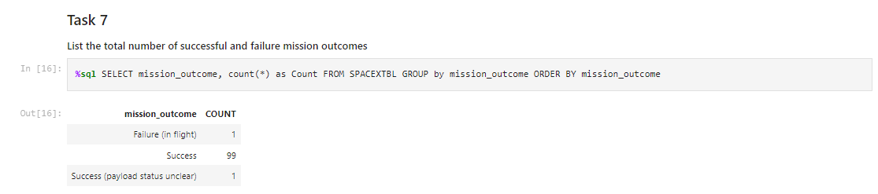
Total Number of Successful and Failure Mission Outcomes
Calculate the total number of successful and failure mission outcomes

Slide 31
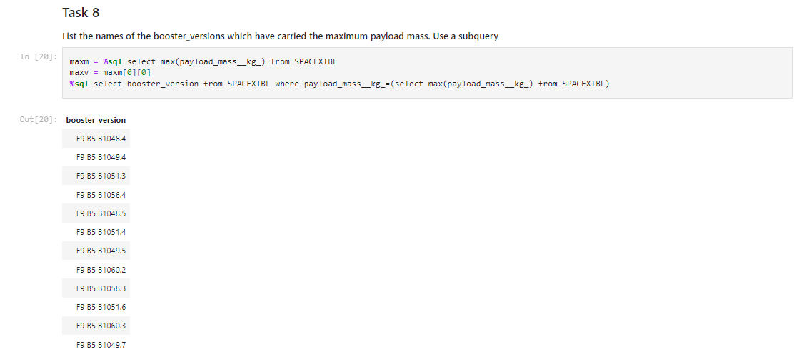
Boosters Carried Maximum Payload
List the names of the booster which have carried the maximum payload mass

Slide 32
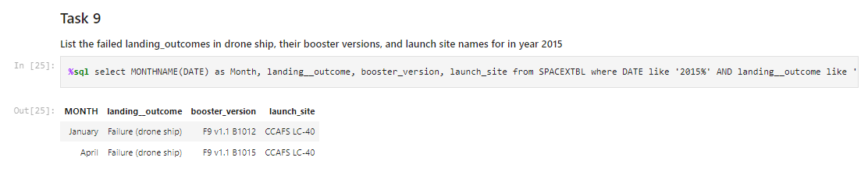
2015 Launch Records
List the failed landing_outcomes in drone ship, their booster versions, and launch site names for in year 2015

Slide 33
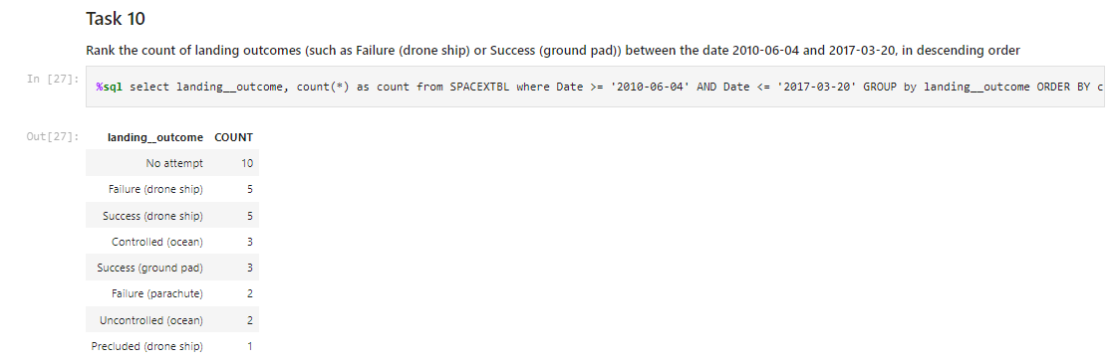
Rank Landing Outcomes Between 2010-06-04 and 2017-03-20
Rank the count of landing outcomes (such as Failure (drone ship) or Success (ground pad)) between the date 2010-06-04 and 2017-03-20, in descending order

Slide 34

Section 3

Slide 35
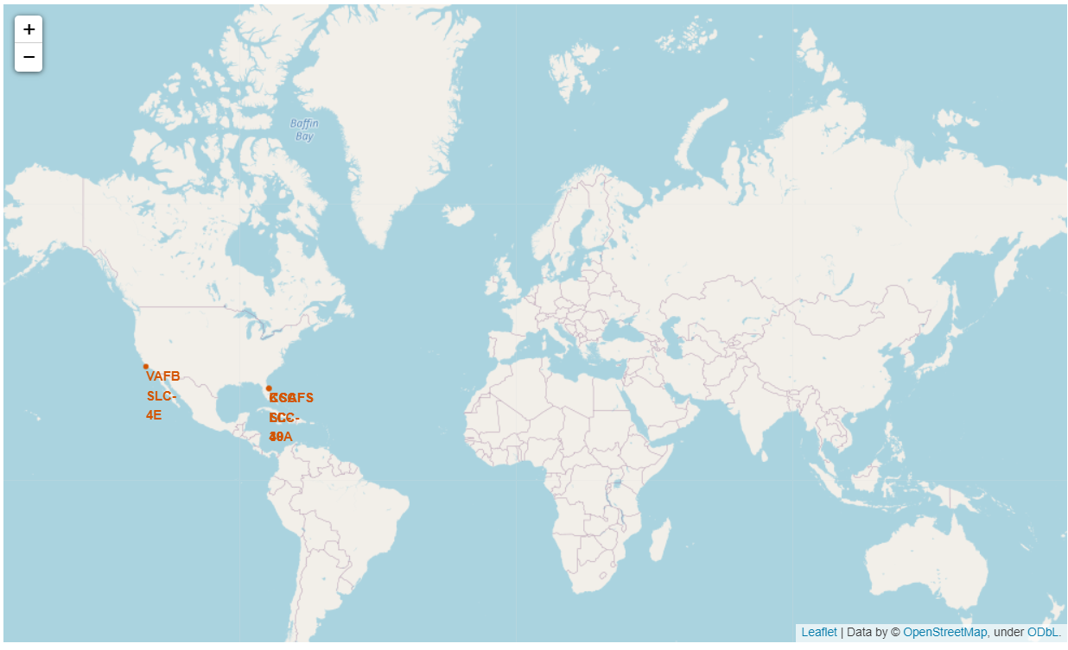
All launch sites global map markers

Slide 36
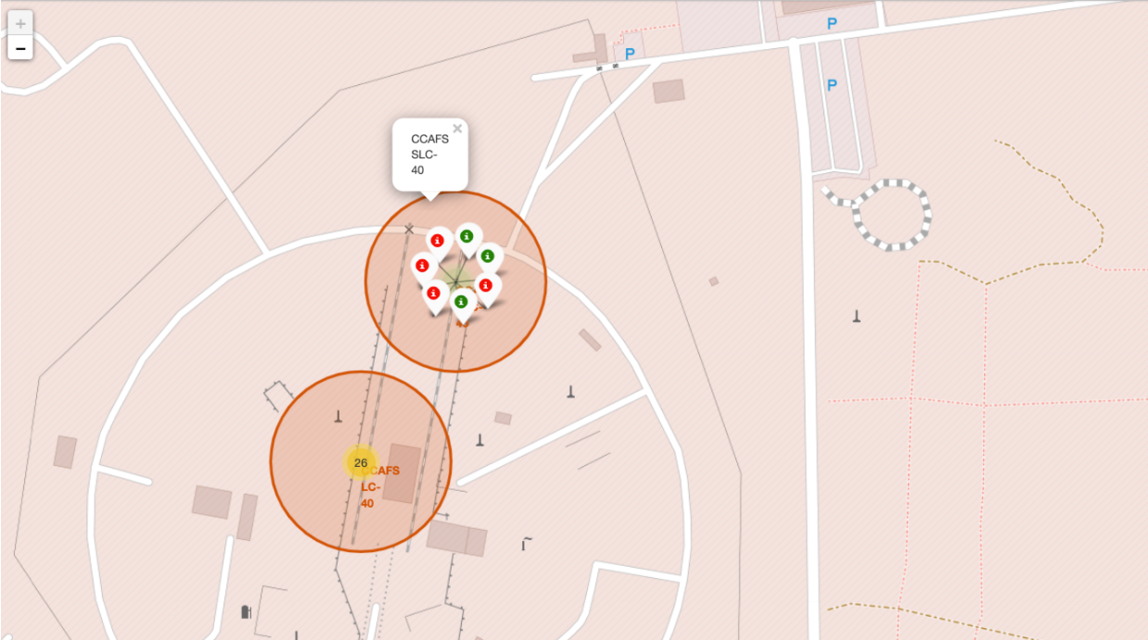
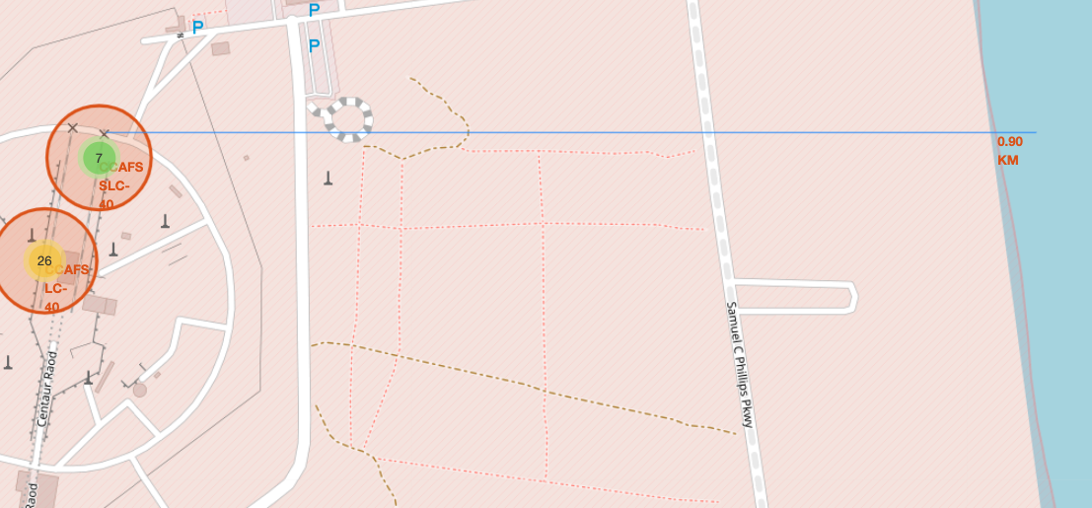
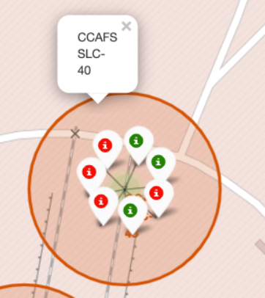
Markers showing launch sites with colour labels
Florida Launch Sites
Green- Successful
Red- Unsuccessful

Slide 37

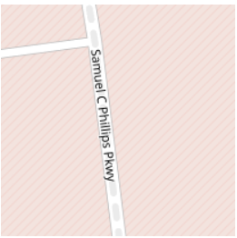

LandMarks
Railway map
Highway
City

Slide 38

Section 4

Slide 39
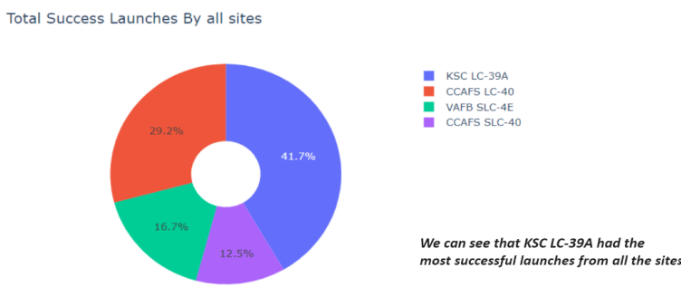
Pie chart showing the success percentage achieved by each launch site

Slide 40
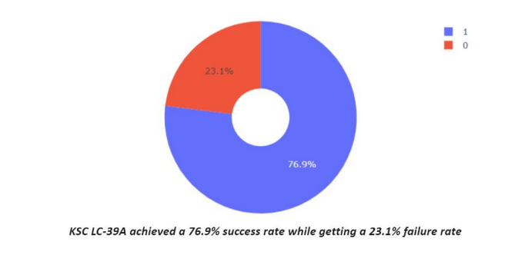
Pie chart showing the Launch site with the highest launch success ratio

Slide 41
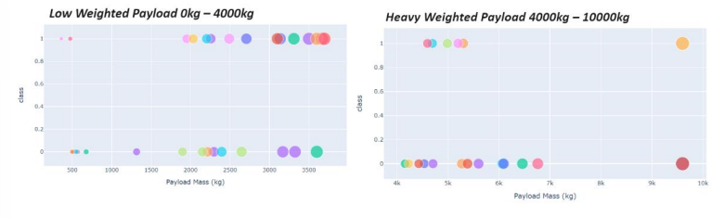
Scatter plot of Payload vs Launch Outcome for all sites, with different
payload selected in the range slider

Slide 42

Section 5

Slide 43
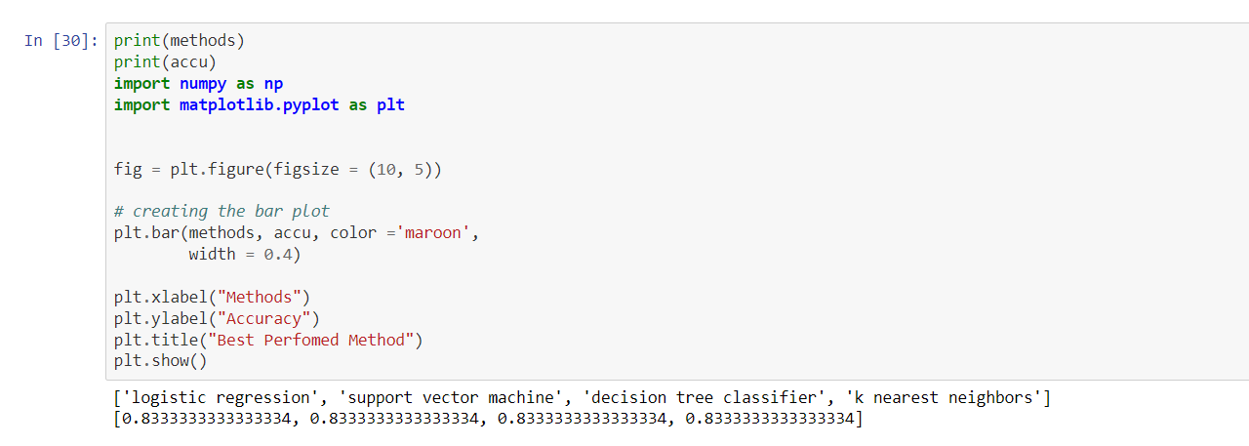
Classification Accuracy

Slide 44
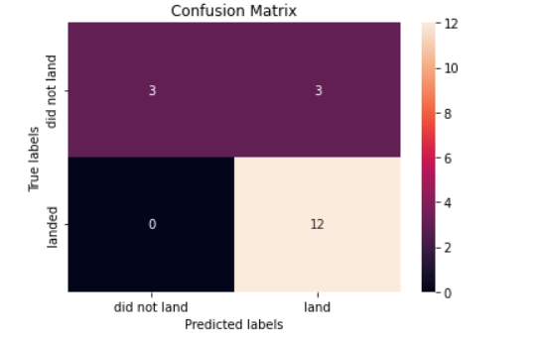
Confusion Matrix
The confusion matrix for the decision tree classifier shows that the classifier can distinguish between the different classes. The major problem is the false positives .i.e., unsuccessful landing marked as successful landing by the classifier.

Slide 45
Conclusions
We can conclude that:
The larger the flight amount at a launch site, the greater the success rate at a launch site.
Launch success rate started to increase in 2013 till 2020.
Orbits ES-L1, GEO, HEO, SSO, VLEO had the most success rate.
KSC LC-39A had the most successful launches of any sites.
The Decision tree classifier is the best machine learning algorithm for this task.

Slide 46


